Slide 1

Neural Substrates of Attention and Awareness
Dan Birman
Gardner Lab
Frisem – 2015-04-17

Slide 4
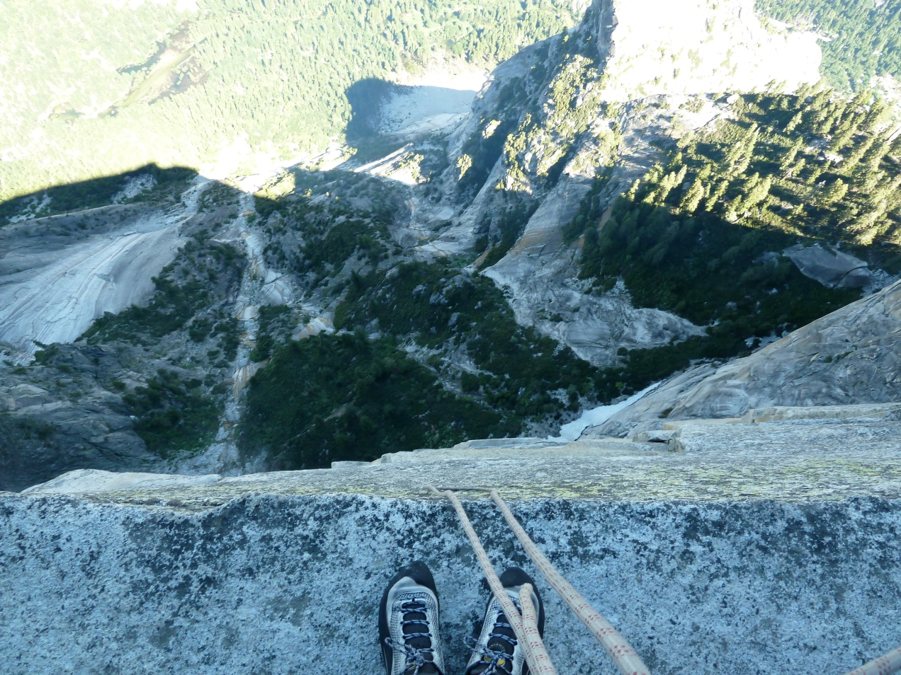

Slide 5
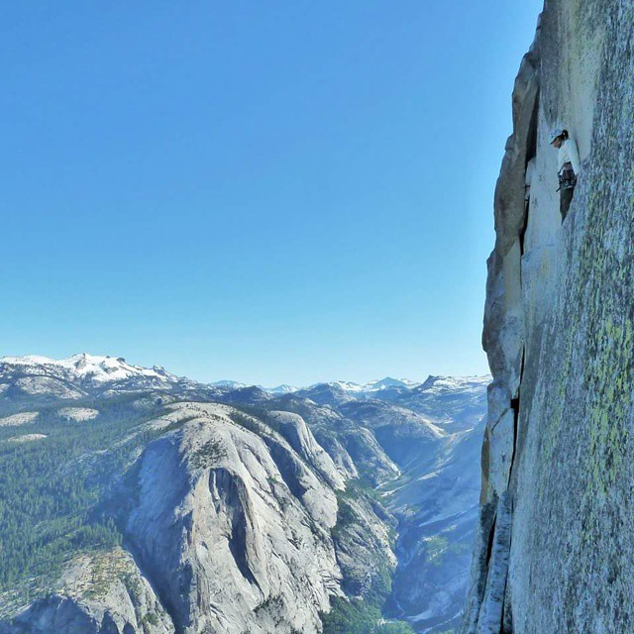

Slide 7







Slide 8
Neural Substrates of Attention and Awareness
Dan Birman
Gardner Lab
Frisem – 2015-04-17

Slide 11


Slide 12


Slide 13
Attention as a Pre-Requisite to Awareness
Dual task designs “pull” attention to one task, causing inattentional blindness for other stimuli.
“we believe […] there is no conscious perception without attention” (Mack & Rock, 1998)

Slide 14
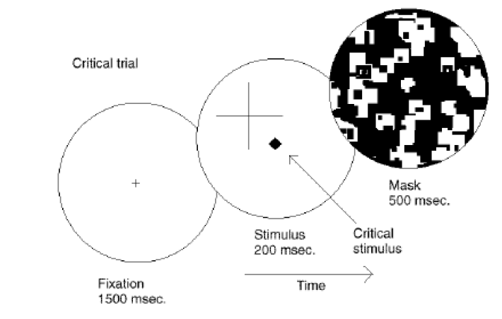
Attention as a Pre-Requisite to Awareness
Dual task designs “pull” attention to one task, causing inattentional blindness for other stimuli.
“we believe […] there is no conscious perception without attention” (Mack & Rock, 1998)
Mack & Rock, 1998
Notes:
There is one situation where attention (seems) to not be a pre-requisite for awareness

Slide 15
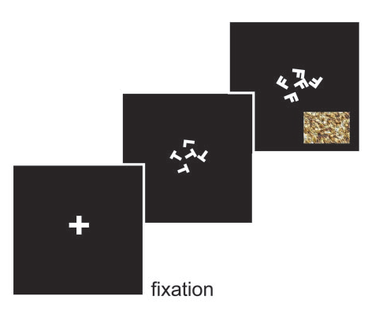
Gist Perception
“The close relationship between attention and
consciousness has led many scholars to conflate these processes“ (Koch & Tsuchiya, 2006)
Li et al., 2002

Slide 16
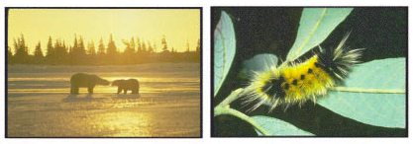
Gist Perception
“The close relationship between attention and
consciousness has led many scholars to conflate these processes“ (Koch & Tsuchiya, 2006)
Li et al., 2002

Slide 17
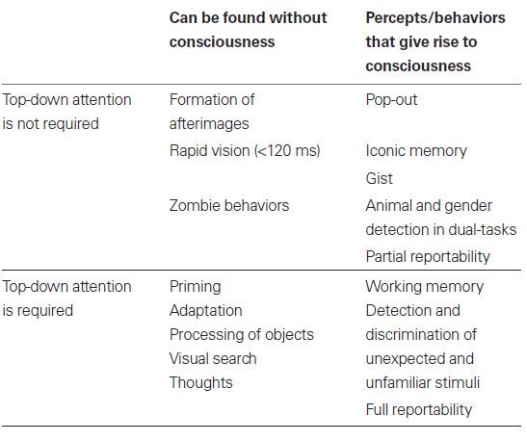
Van Boxtel et al. 2010.

Slide 18
Conceptual Overview: Task Design
Where are the representations for different properties of stimuli held in the brain?
Notes:
First attempt: dual

Slide 19
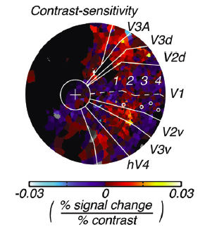
Conceptual Overview: Task Design
Where are the representations for different properties of stimuli held in the brain?
Notes:
First attempt: dual

Slide 20
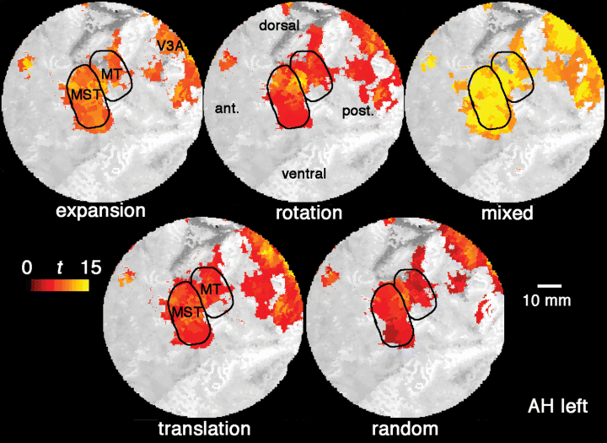
Conceptual Overview: Task Design
Where are the representations for different properties of stimuli held in the brain?
Notes:
First attempt: dual

Slide 21
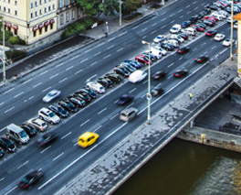
Conceptual Overview: Task Design
Where are the representations for different properties of stimuli held in the brain?
What are the neural effects of pushing attention to a specific location or feature?
Notes:
First attempt: dual

Slide 22
Conceptual Overview: Task Design
Where are the representations for different properties of stimuli held in the brain?
What are the neural effects of pushing attention to a specific location or feature?
How can we measure awareness while manipulating attention?
Notes:
First attempt: dual

Slide 23
Van Boxtel et al. 2010.

Slide 24
Cannot Discriminate
(Unaware)
Can Discriminate
(Aware)
Catch Trials
(Un-attended)
A
Cued
(Attended)

Slide 25
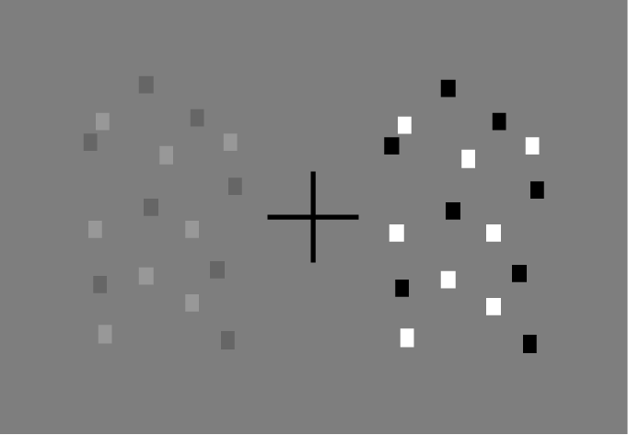
Task Design

Slide 26
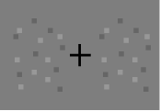
Task Design
Able to Discriminate (Aware)
Unable to Discriminate (Un-Aware)
A difference does exist—despite
a lack of awareness

Slide 27
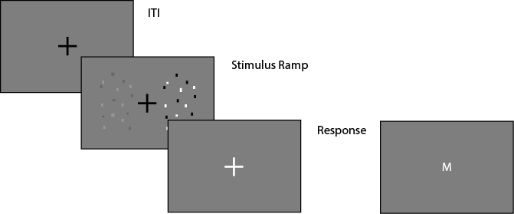
Task Design

Slide 28
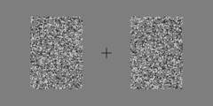
Task Design

Slide 29
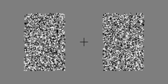
Task Design

Slide 30


Task Design
Cued: Contrast
Catch: Coherence
Cued: Coherence
Catch: Contrast

Slide 31
Cannot Discriminate
(Unaware)
Can Discriminate
(Aware)
Catch Trials: Coherence
(Un-attended)
A
Cued: Contrast
(Attended)

Slide 32
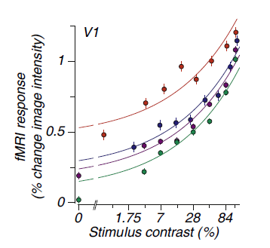
Neural Substrate of Attention
BOLD Magnitude
Attended
Pestilli et al., 2011

Slide 33
Neural Substrate of Attention
BOLD Magnitude
Attended
Unattended
Pestilli et al., 2011

Slide 35
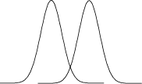

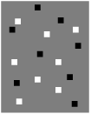
Neural Substrate of Attention
Bold Response Magnitude
Attended
Unattended

Slide 36
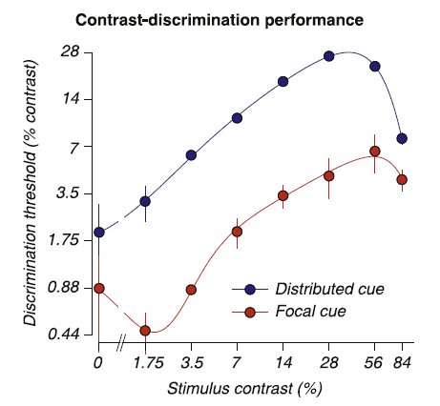
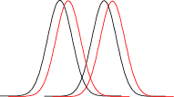
Neural Substrate of Attention
Attended
Unattended
Pestilli et al., 2011

Slide 37
Neural Substrate of Attention
Attended
Unattended
Pestilli et al., 2011

Slide 38
Neural Substrate of Attention
Attended
Unattended

Slide 39
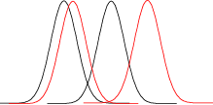
Neural Substrate of Attention
Attended
Unattended

Slide 40
Neural Substrate of Attention
Attended
Unattended

Slide 41
Neural Substrate of Attention
Behavioral Performance ←→ BOLD Magnitude
Attended
Unattended
Pestilli et al., 2011

Slide 42
Neural Substrate of Awareness
Attended
Unattended
7%
14%

Slide 43
Neural Substrate of Awareness
Psychophysical Threshold: ~80% Performance
Attended
Unattended
7%
14%

Slide 44
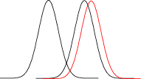
Neural Substrate of Awareness
Attended
Unattended
7%
14%

Slide 45
Neural Substrate of Awareness
Attended
Unattended
7%
14%
Pestilli et al., 2011

Slide 46
Neural Substrate of Awareness
Attended
Unattended

Slide 47
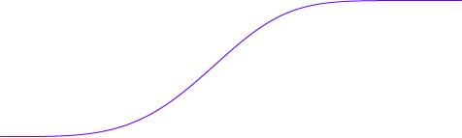
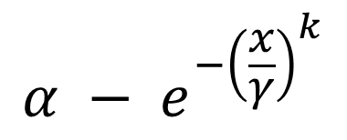
Neural Substrate of Awareness
$$α − e^{−{\left(\frac{x}{γ}\right)}^{k}}$$
Attended
100%
Unattended
Performance (%)
50%
.44 .88 1.75 3.5 7 14 28
Threshold Size

Slide 48
Neural Substrate of Awareness
Attended
100%
~80% Performance
Unattended
Performance (%)
50%
.44 .88 1.75 3.5 7 14 28
Threshold Size

Slide 49
Neural Substrate of Awareness
Attended
100%
~80% Performance
Unattended
Performance (%)
3.5% Contrast
Threshold
50%
.44 .88 1.75 3.5 7 14 28
Threshold Size

Slide 50
Neural Substrate of Awareness
Unaware:
No Discrimination
Aware:
Can Discriminate
Attended
100%
Unattended
Performance (%)
50%
.44 .88 1.75 3.5 7 14 28
Threshold Size

Slide 51
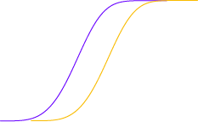
Neural Substrate of Awareness
Unaware:
No Discrimination
Aware:
Can Discriminate
Attended
100%
Unattended
Performance (%)
50%
.44 .88 1.75 3.5 7 14 28
Threshold Size

Slide 52
Neural Substrate of Awareness
Unaware:
No Discrimination
Aware:
Can Discriminate
Attended
100%
Unattended
Performance (%)
50%
.44 .88 1.75 3.5 7 14 28
Threshold Size

Slide 53
Neural Substrate of Awareness
Attended
100%
Unattended
Performance (%)
50%
.44 .88 1.75 3.5 7 14 28
Threshold Size

Slide 54
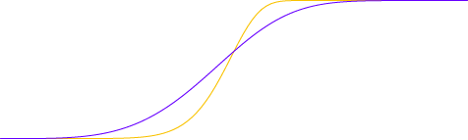
Neural Substrate of Awareness
Attended
100%
Unattended
Performance (%)
50%
.44 .88 1.75 3.5 7 14 28
Threshold Size

Slide 55
Neural Substrate of Awareness

Slide 56
Neural Substrate of Awareness

Slide 57
Neural Substrate of Awareness

Slide 58
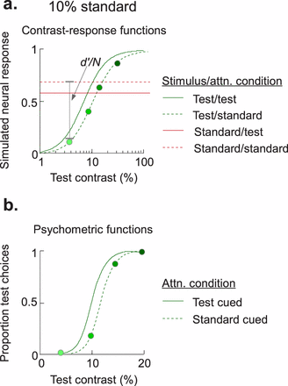
Pestilli et al. 2011
Cutrone et al. 2014

Slide 59
Neural Substrate of Awareness

Slide 60
Neural Substrate of Awareness
Outside
Inside Scanner

Slide 61
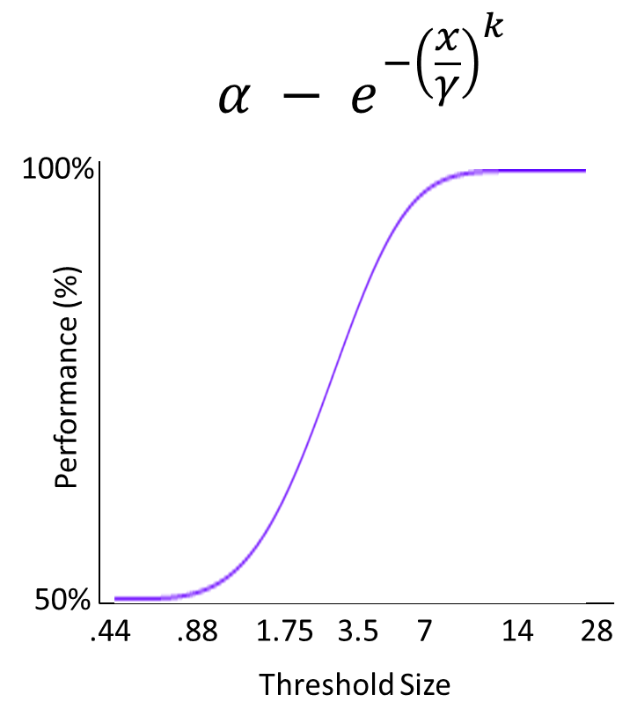
If attention and awareness are dissociable, we expect to see dissociated neural correlates.
BOLD Response
Modulated by Attention
Discrimination
Performance
Notes:
First attempt: dual

Slide 62
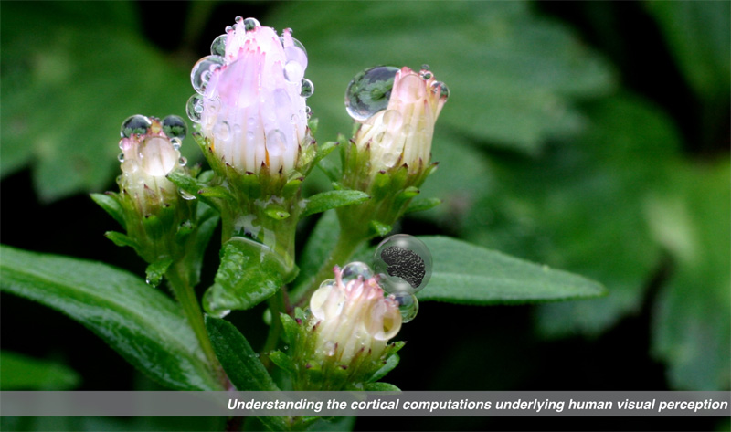

Gardner Lab @ Stanford University
Thank You!
Justin Gardner
Steeve Laquitaine
1st Year Cohort

